Slide 1
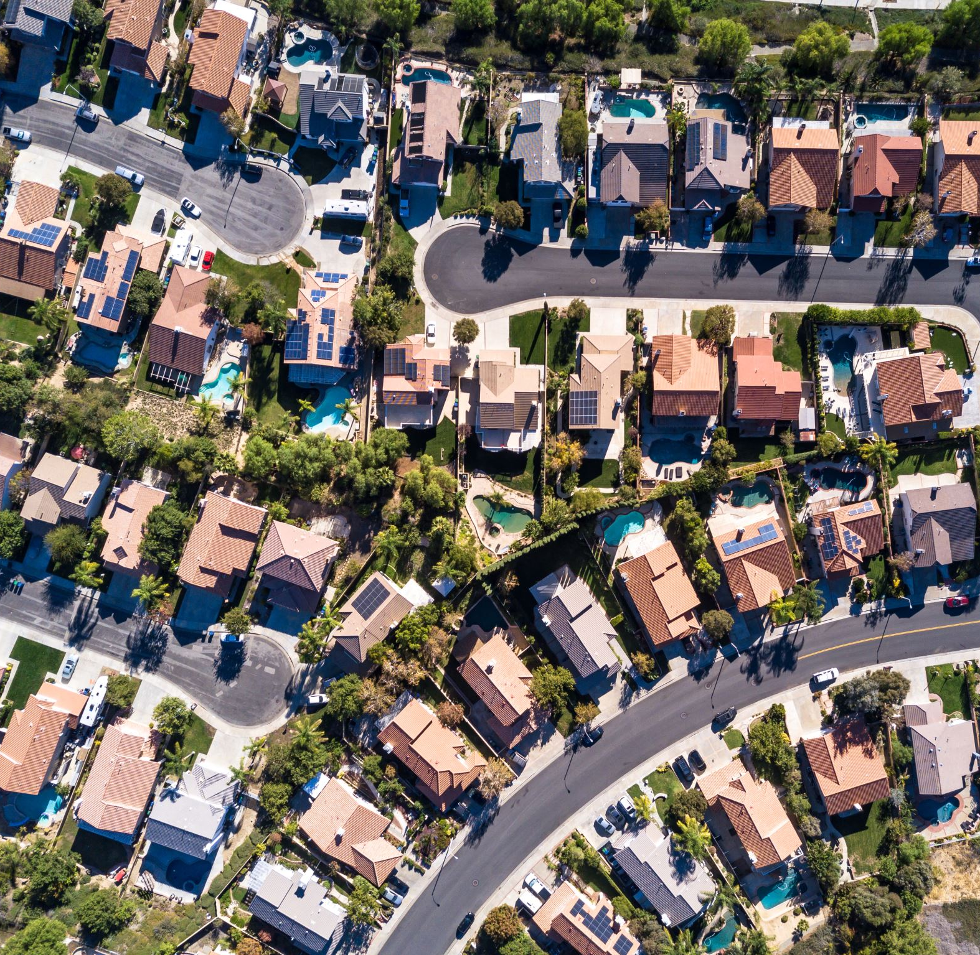
Analysis of San Francisco Housing Market
Methods and tools to act against displacement and gentrification
Pietro Bogani, Tomaso Castellani, Sara Tonazzi

Slide 2
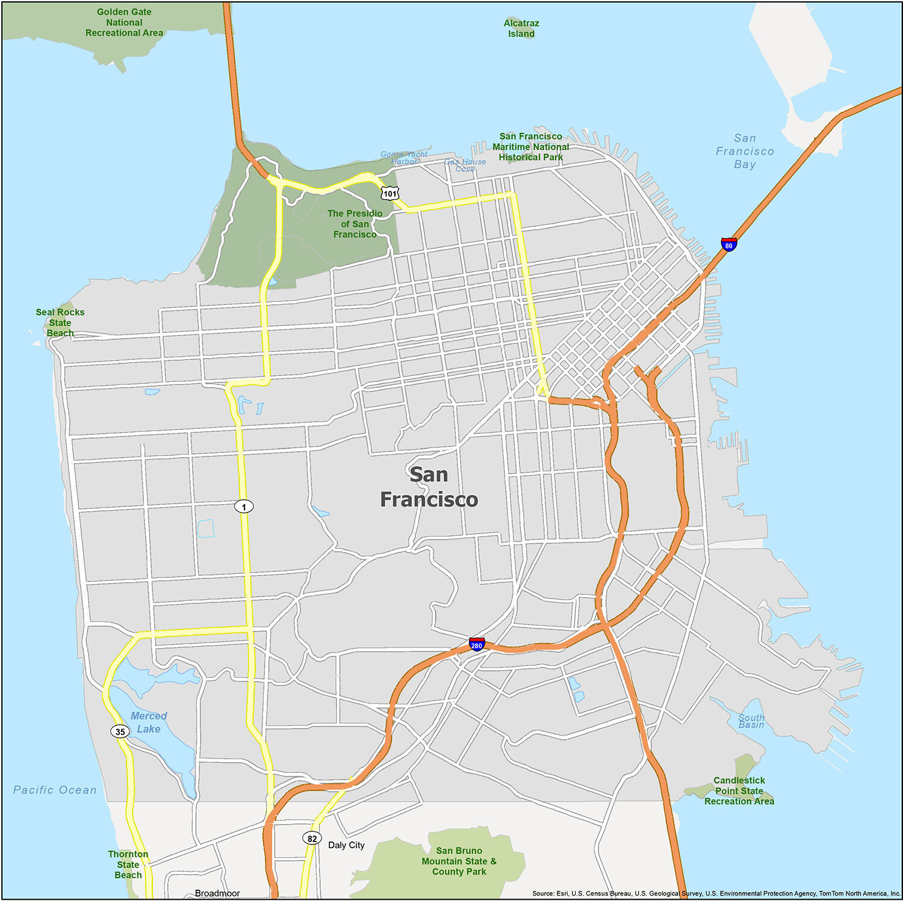
The problem
Gentrification and displacement
The process whereby the character of a urban area is changed by wealthier people moving in, displacing current inhabitants in the process.
Gentrification in San Francisco has increased significantly since the 1990s, driven by a strong demand for tech workers from local startups and Silicon Valley companies.
This process affected negatively the social demographic structure of the city, as SF was becoming the most expensive city in the US.

Slide 3
Goals
Use statistical methods and develope models to understand how the SF housing market has changed in the recent 15 years and which factors drived these changes.
Provide to the local government tools to tackle the problem of gentrification and displacement.
Further validate previous papers on the topic.

Slide 4
Dataset

Slide 5




Buyout
&
Evictions
Rent
Dataset
Parcels
Constructions

Slide 6
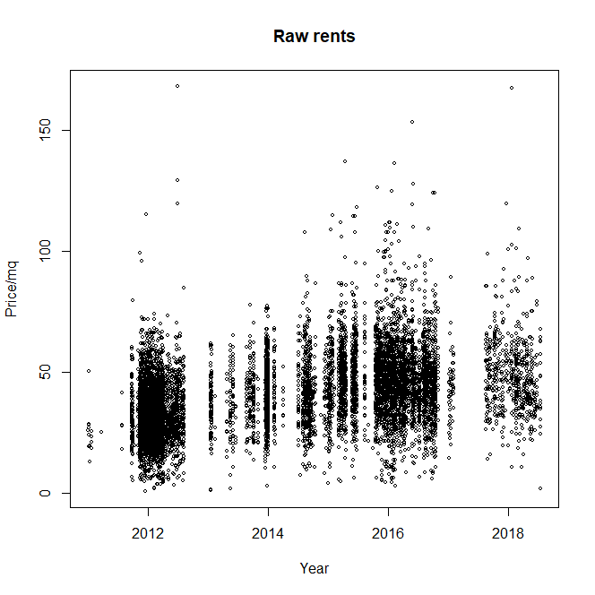
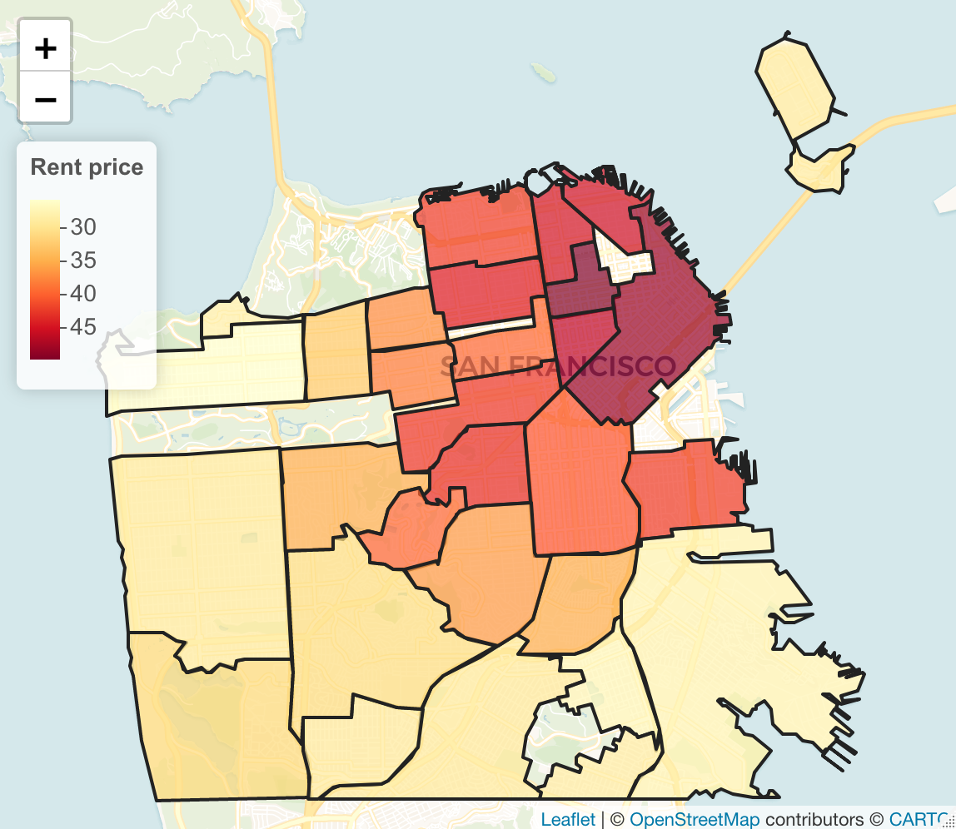
Datasets
Rent
Source: Craiglist.com
Main information:
Neighborhood
Price/mq
Date of the advertisement

Slide 7
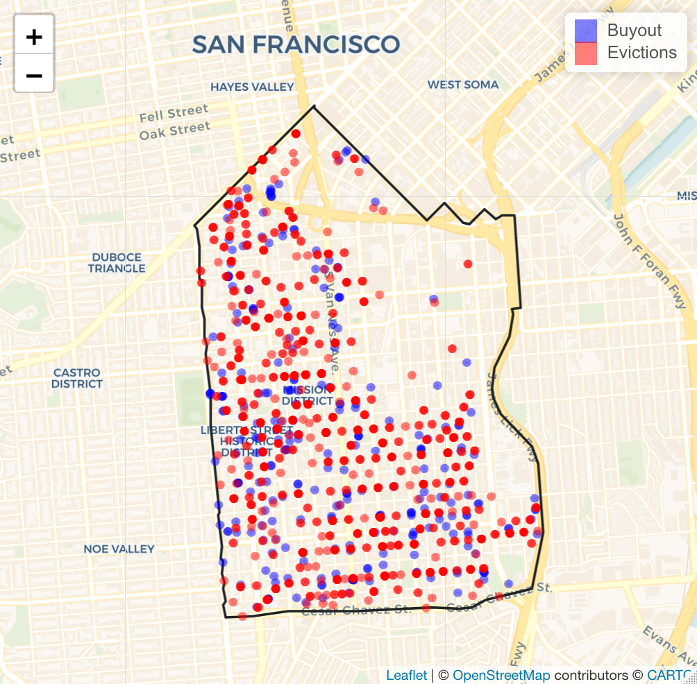

Datasets
Source : SF government
(datasf.org)
Main information:
Address (geogoded to coordinates)
Neighborhood
Date
Buyout amount
Evictions&
Buyout

Slide 8
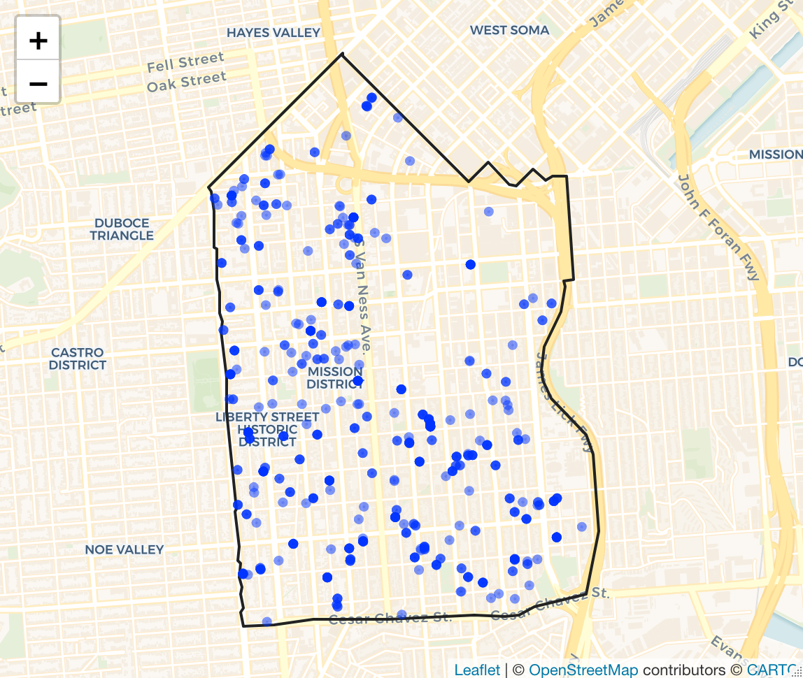
Datasets
Source : SF government ( datasf.org)
Main information:
Address (geocoded to coordinates)
Date of permit emission
Existing and proposed housing units
Construction
«Demand and supply» vs «Higher attractiveness of nearby houses»

Slide 9
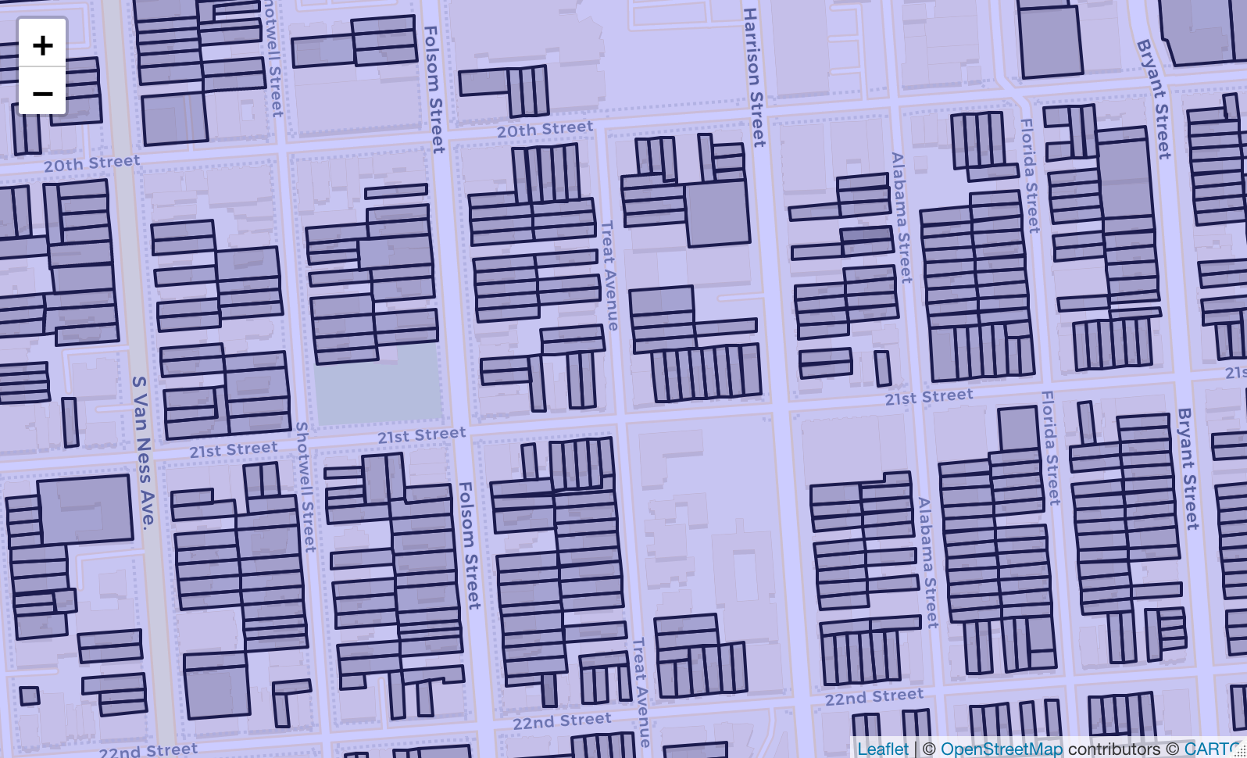

Datasets
Source : SF government (datasf.org)
Main information:
Latitude and longitude of the vertices of the parcel
Number of house units for each parcel
Parcel

Slide 10
Exploratory analysis

Slide 11
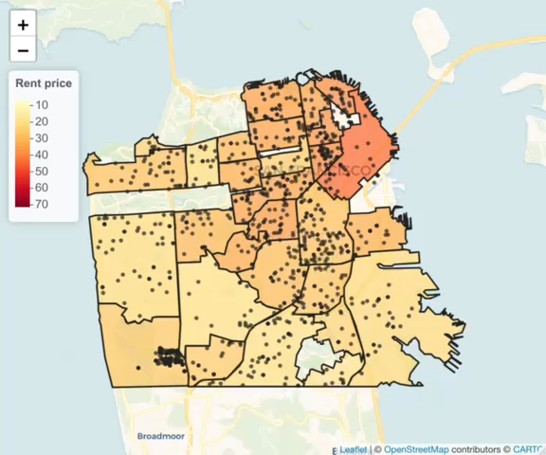
Map of
prices and evictions evolution

Slide 12
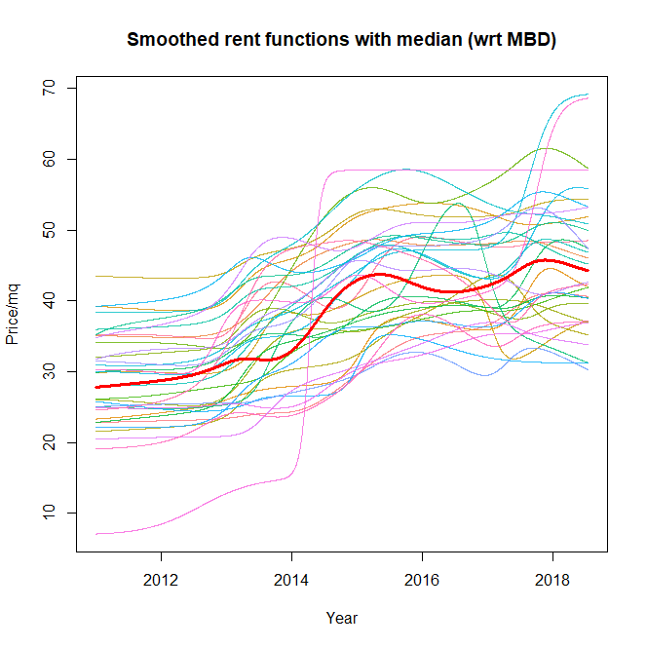
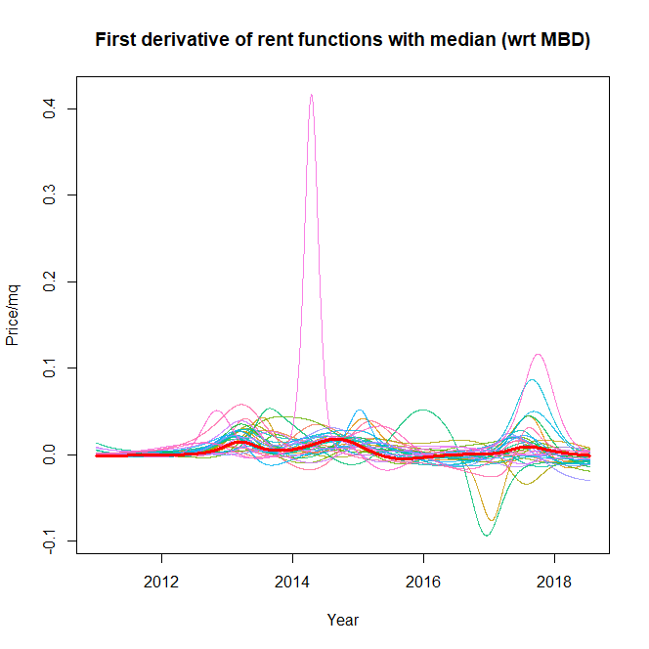
Rent
functions

Slide 13
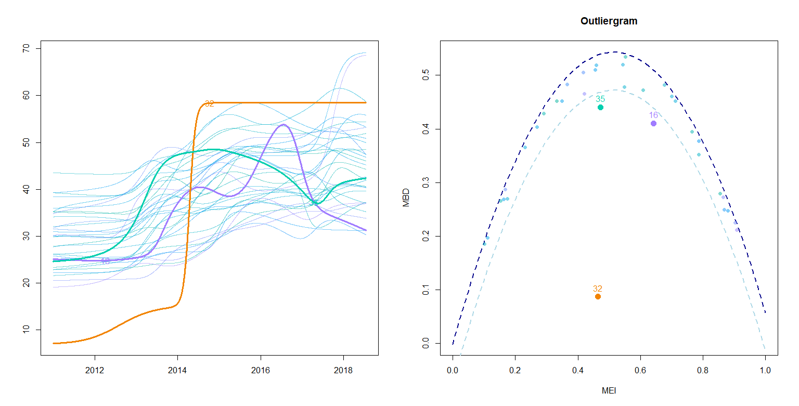
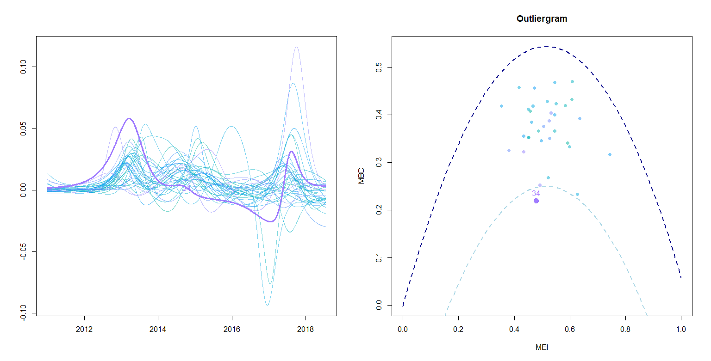
Outlier Detection
32
Treasure Island
34
Western Addition

Slide 14
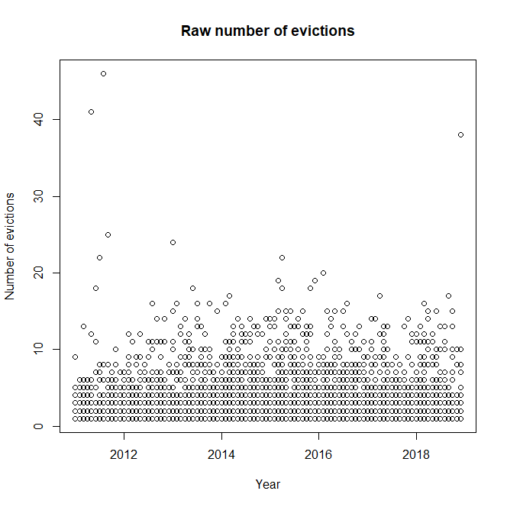
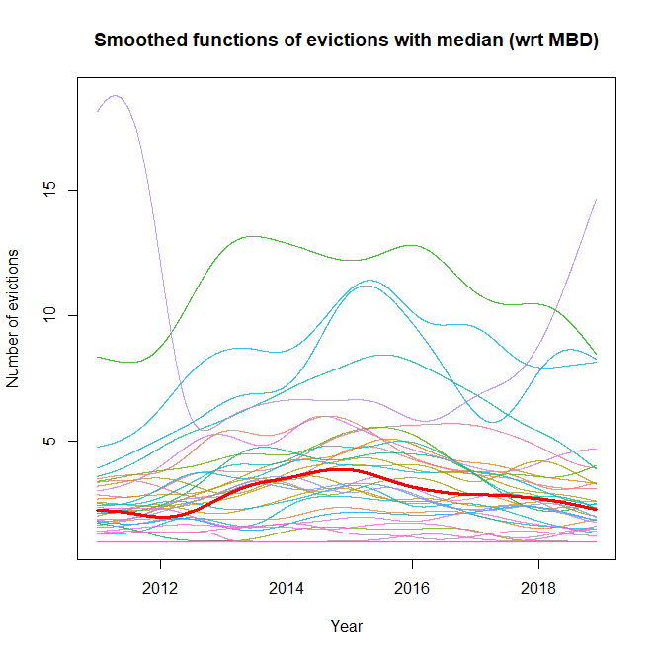
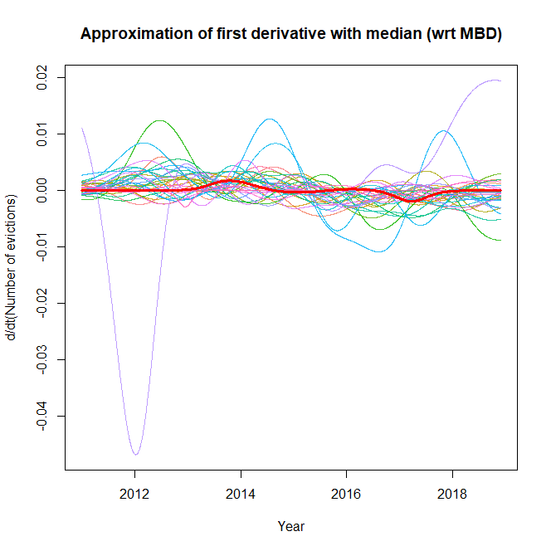
Evictions functions

Slide 15
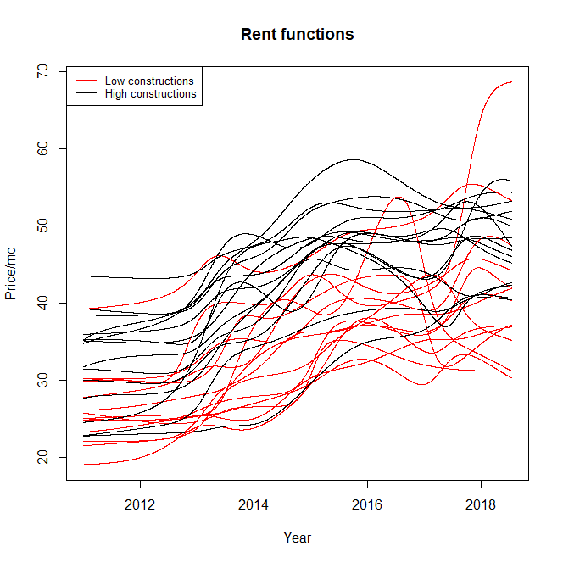
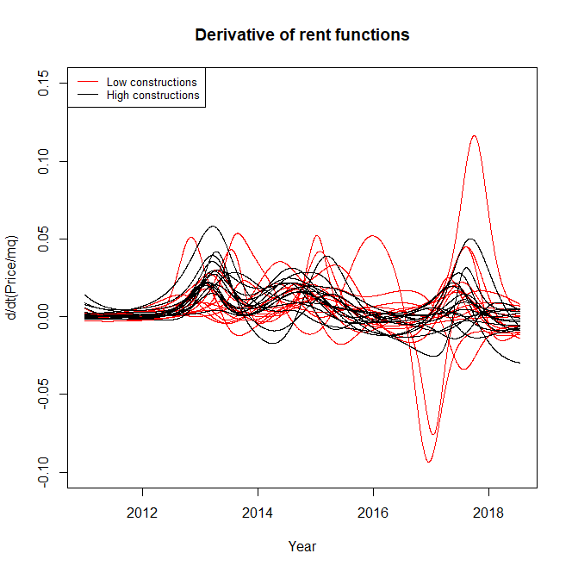
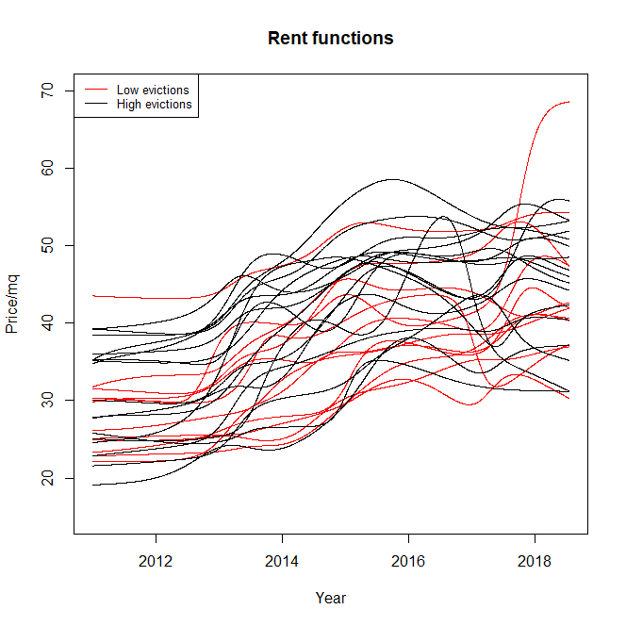
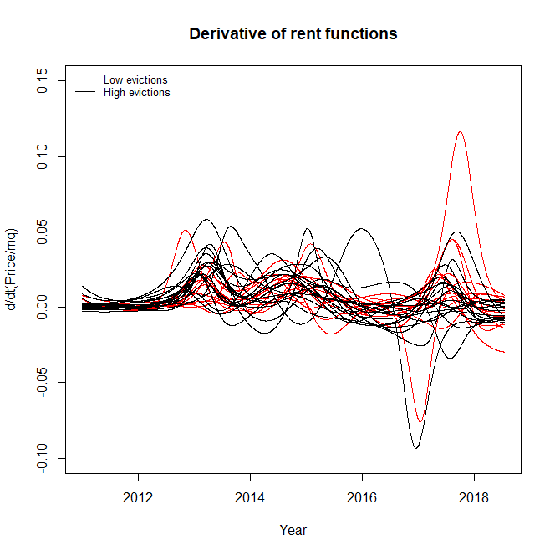
Test on
rent functions

Slide 16
Constructions effect

Slide 17
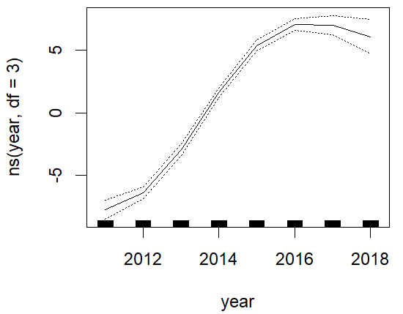
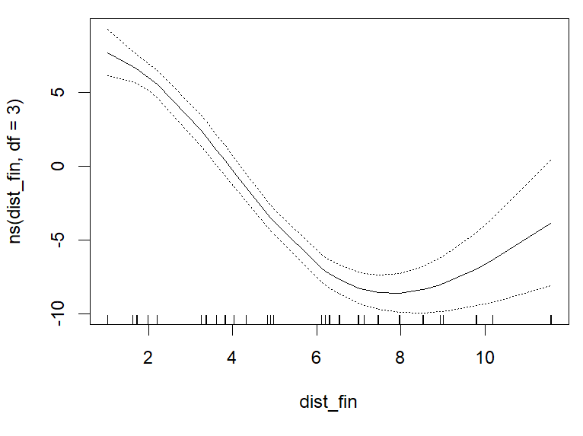

GAM model
With
neighborhood granularity
$$rent \sim year+\sum_{t=year−4}^{year}{{new constructions}_{nhood,t}}+{dist financial district}_{nhood}+dist Caltrain {Station}_{nhood}$$

Slide 18
Future analysis

Slide 19
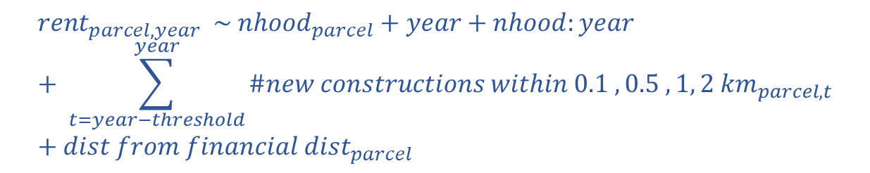
GAM model
With
parcel granularity
Smoothing of the rent prices over the residential area of SF
Calculation of the amount of new costructions close to each parcel
Implement a GAM model based on:
$${rent}_{parcel, year} \sim {nhood}_{parcel}+year+nhood:year+ \sum_{t=year−threshold}^{year}{{\#new constructions within 0.1 , 0.5 ,1, 2 km}_{parcel,t}}+{dist from financial dist}_{parcel}$$
Consider to add other variables such as ‘Google bus stops’

Slide 20
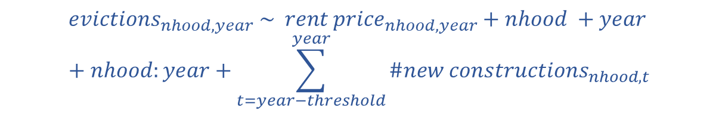
Other ideas
Implement a GAM model based on:
$${evictions}_{nhood,year} \sim {rent price}_{nhood,year}+nhood +year+nhood:year+\sum_{t=year−threshold}^{year}{{\#new constructions}_{nhood,t}}$$
Improve the functional tests implementing different methods to obtain different partions (eg. Functional clustering)
Consider to add methods based on conformal prediction and robust statistics

